Slide 1
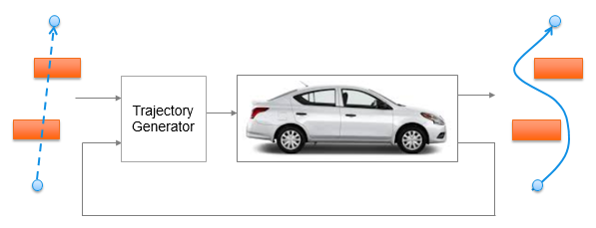
Trajectory Generation in High Density Environment
Mid-Term Review
Suvo Ganguli
Alberto Speranzon (Presenter)
Apr 9, 2018

Slide 2
Agenda
Project Overview – 1 min
Summary of Accomplishments – 5 min
Summary of Remaining Work & Challenges – 5 min
PI: GO or NO GO Recommendation – 1 min
Selection Committee Q&A – 3 min
Honeywell Internal

Slide 3
Project Overview
Project Summary
PI: Suvo Ganguli, Alberto Speranzon
RTC: CNS
Project Name: Trajectory Generation in High Density Environment
Budget: 75K
Problem Statement/Objective:
Trajectory generation in cluttered environment is a key problem to solve for autonomous operations
The goal of this project is to understand the tradeoffs between the different parameters used to design trajectory generation in presence of obstacles
Deliverables
Completed
Development of 2D trajectory generation software
Tradeoff studies
Remaining (with proposed change)
Development of 2D trajectory generation software without using costly / time-consuming global planner, upon encountering pop-up obstacles (a realistic scenario)
Tradeoff studies
Project Status
YTD Spend: 30K
Approx % WORK Complete: 50%
Probability of completion to proposed schedule: 95%
Honeywell Internal

Slide 4
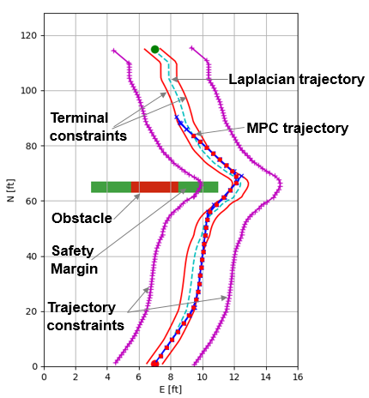
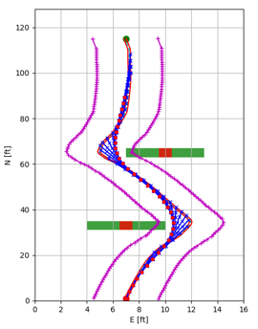
Summary of Accomplishments
1 Obstacle
2 Obstacles
CPU Time (CT) variation with the tradeoff parameters – number of trajectory steps (N), number of obstacles (no), time step (T) and number of states (ns) are as follows:
CT increases with N as 2^{N}
CT increases with no as (1- k.e^{-b.no})
CT decreased with increase in T (for same horizon length)
CT decreased from ns = 4 to ns = 6 (due to increase in bandwidth for same weights)
Increase in horizon distance (equivalent to N) leads to:
Smoother trajectory
Increase in comfort level
Decrease in control effort
This is because with increase in horizon distance, control action can be taken earlier.
This is at the cost of increase in computation time
Analysis not shown in this slide deck
Laplacian trajectory – a potential flow based trajectory. Used for global planning. Drawback - does not take into account vehicle dynamics and constraints
MPC trajectory – Model Predictive Control based trajectory. Used for local planning. Benefit - does take into account vehicle dynamics and constraints
Honeywell Internal

Slide 5
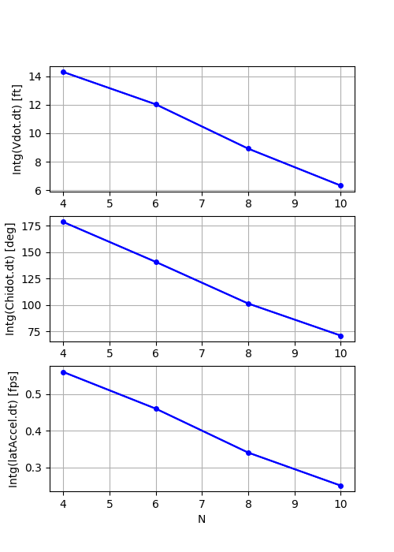
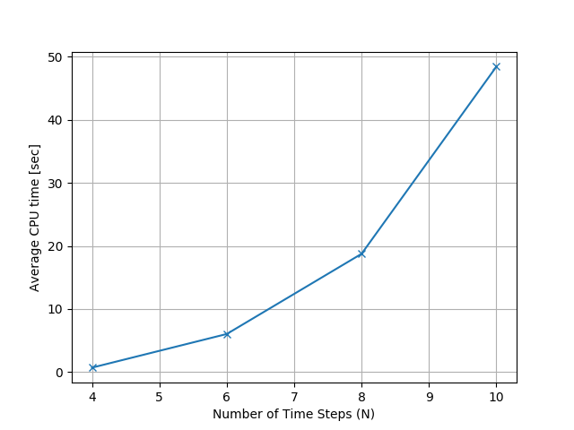
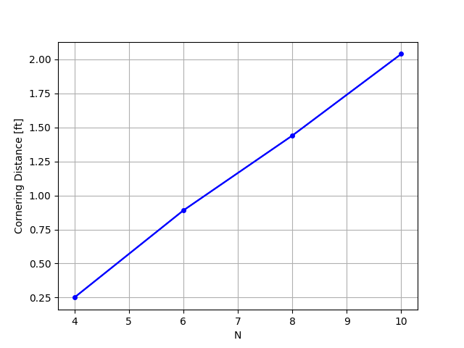
Summary of Tradeoff Charts
Increase in N (equivalent to horizon distance) leads to:
Smoother trajectory
Decrease in control effort
Increase in comfort level
At the cost of
Increase in computation time
Control Effort
(V)
Computation time
Trajectory Smoothness
Control Effort
(Chidot)
1
Comfort Level
No. of Time Steps (N)
No. of Time Steps (N)
No. of Time Steps (N)

Slide 6
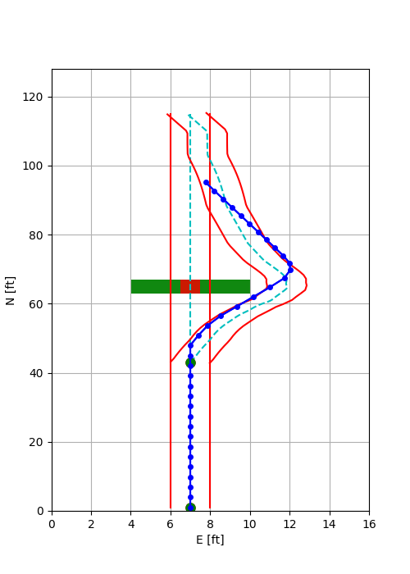
Summary of Remaining Work and Challenges
Proposed change
Development of 2D trajectory generation software without re-computation of initial trajectory using costly / time-consuming global Laplacian planner, upon encountering pop-up obstacles (a realistic scenario)
List of remaining tasks (for proposed change):
Redefine MPC problem formulation (5K, 3 weeks)
Update 2D trajectory generation software (20K, 5 weeks)
Perform tradeoff studies (15K, 3 weeks)
Create report/slides (5K, 1 week)
Challenges
Increase in complexity of proposed 2D trajectory generation software
Increase in effort compared to usage of existing global Laplacian planner
Resources:
Suvo Ganguli (67%)
Alberto Speranzon (5%)
Re-computed Laplacian trajectory
Pop-up obstacle
Initial Laplacian trajectory
Figure shows re-computation of Laplacian Planner trajectory after encountering a pop-up obstacle
Honeywell Internal

Slide 7
PI: GO or NO GO Recommendation
What is the PI’s recommended position on project continuance, based on?
Recommendation: Continue with the project with the proposed change, which will reduce re-computation time when encountering pop-up obstacles (a realistic scenario)
Reason: We have met our mid-term goal of
developing the 2D trajectory software
performing the tradeoff studies
in time within budget
Remaining effort vs time
2D trajectory generation software development without re-computation of global Laplacian Planner and redo tradeoff studies
Very likely to complete the project within remaining time (3 months)
Budget
Spent 30K out of 35K planned for mid-term review
45K remaining
Resource availability
Suvo – 67% (earlier 50%)
Alberto – 5%
Risk
2D trajectory generation without re-computation of Laplacian Planner likely to take more development time than currently planned for. Trade-off studies may be partially completed.
Honeywell Internal

Slide 8
Q&A
Honeywell Internal

Slide 9
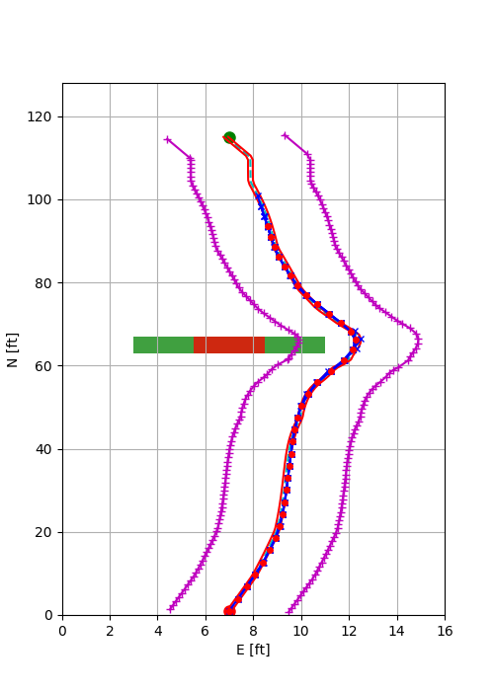
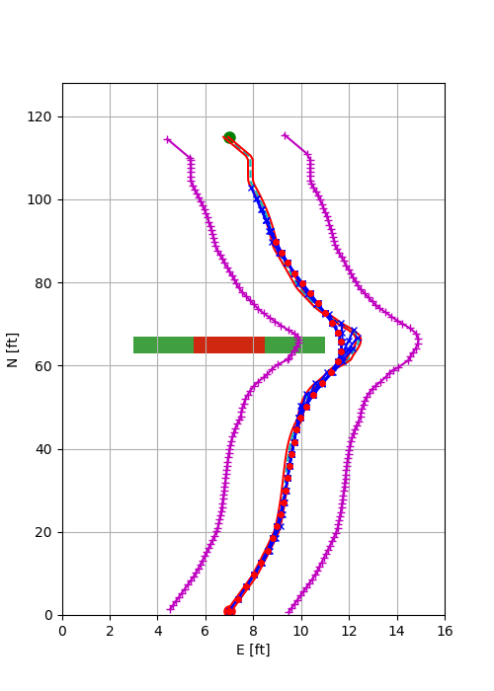
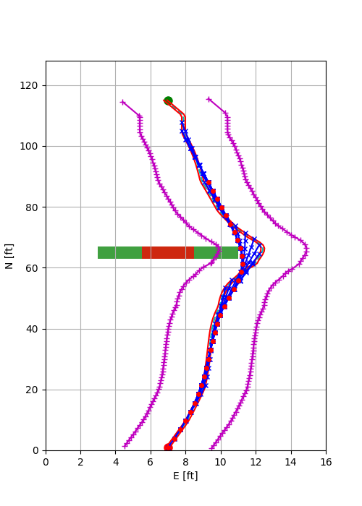
Trajectory Variation with No. of Time Steps
With number of states = 4 and number of obstacles = 1, as we increase the number of time steps = 4, 6, 8, we observe that the trajectory gets smoother
If a “ribbon” being pulled along a circuitous path, the longer the ribbon, the wider the turns.
N = 4
N = 6
N = 8

Slide 10
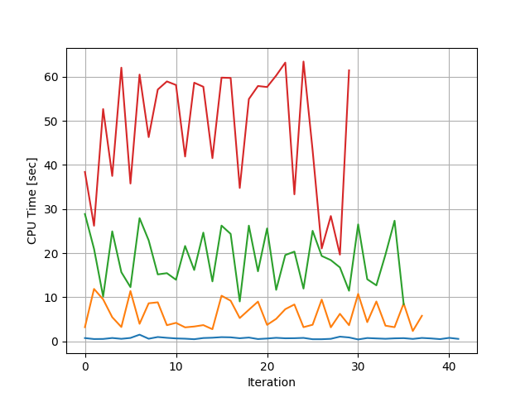
CPU Time vs No. of Time Steps (CT vs N)
CPU mean time increases with N as 2^{N} as more computation is required for a larger horizon
N=10
N=8
N=6
N=4

Slide 11
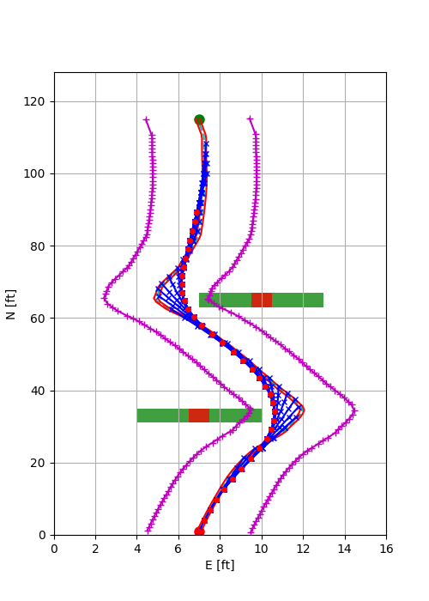
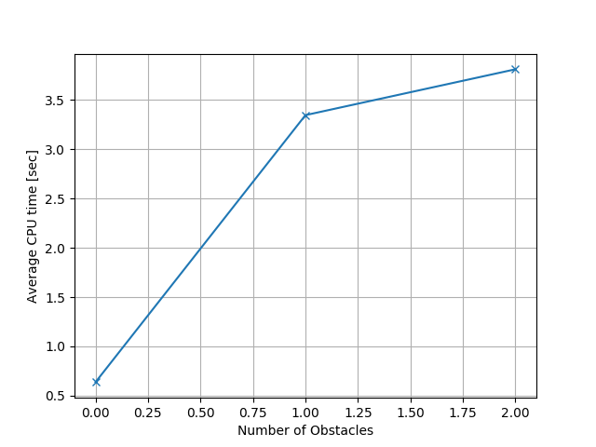
CPU Time vs No. of Obstacles (CT vs no)
CPU mean time increases with N as k(1-e^{-bno}) as the number of constraints are active for a longer duration
1 Obstacle
2 Obstacles

Slide 12
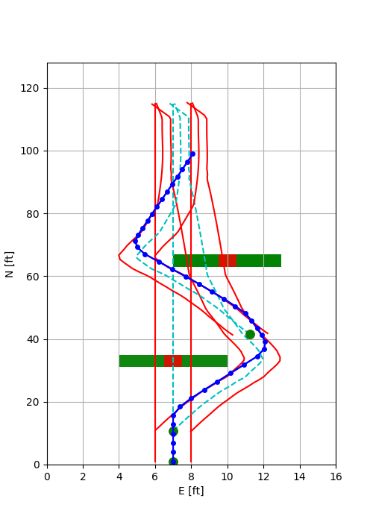
Trajectory Generation for Pop-Up Obstacles

